Slide 1
B-Bay
Website auction online

Slide 2
TEAM
Tạ Việt Hùng
Phạm Hà Hoàng Nam
Nguyễn Song Toàn
Nguyễn Anh Quân

Slide 3
DESCRIPTION
Website auction online
Helps organizations and individuals exchange and trade quickly and conveniently through auctions online.

Slide 4
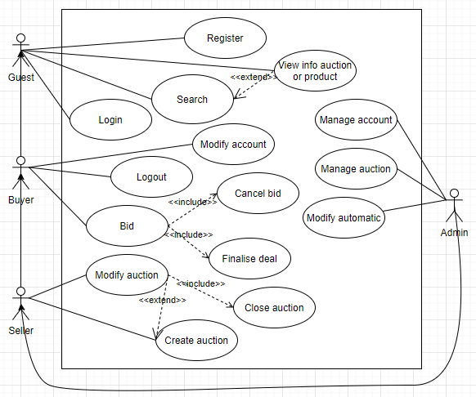

Slide 5
Thanks for watching

